Slide 1
ermB ROCker model summary

Slide 2
Model 1
ermB+ Clade positive
All other clades negative

Slide 3
ermX+
ermO
ermD
ermD
ermB+
Model 1: ermB+
Positive
Negative
ermB
ermT
ermC
ermG
ermY
Erm33
Erm45
Erm47
No erm genes
Ribosomal RNA small subunit methyltransferase A
0.8

Slide 4
ermB+ ROCker model using ROCkOut – 150bp reads

Slide 5
Model 2
ermX+ Clade positive
All other clades negative

Slide 6
ermX+
ermO
ermD
ermD
ermB+
Model 1: ermX+
Positive
Negative
No erm genes
Ribosomal RNA small subunit methyltransferase A
0.8

Slide 7
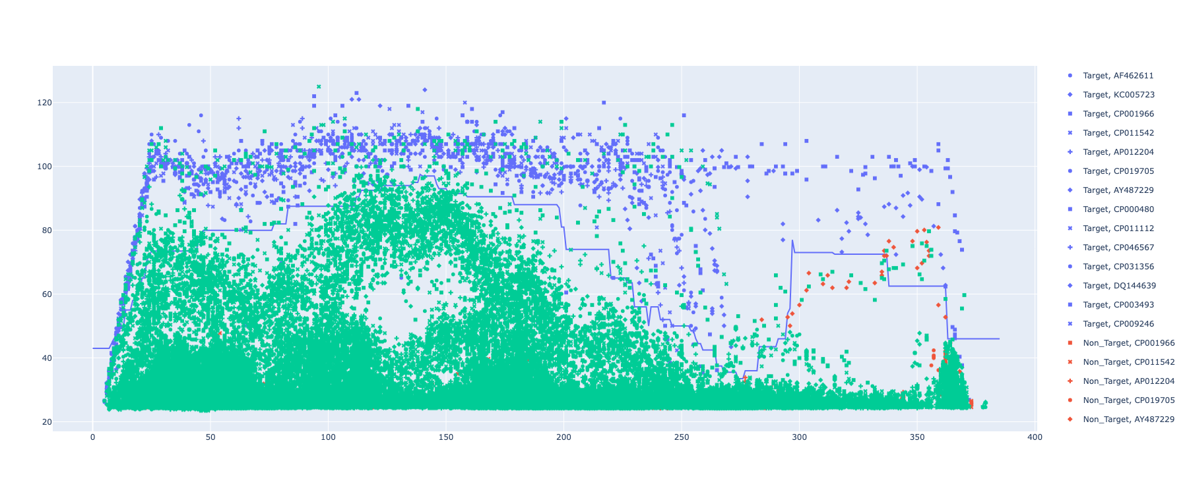
ermX+ ROCker model using ROCkOut – 150bp reads

Slide 8
Model 3
ermO Clade positive
All other clades negative

Slide 9
ermX+
ermO
ermD
ermD
ermB+
Model 1: ermO
Positive
Negative
No erm genes
Ribosomal RNA small subunit methyltransferase A
0.8

Slide 10
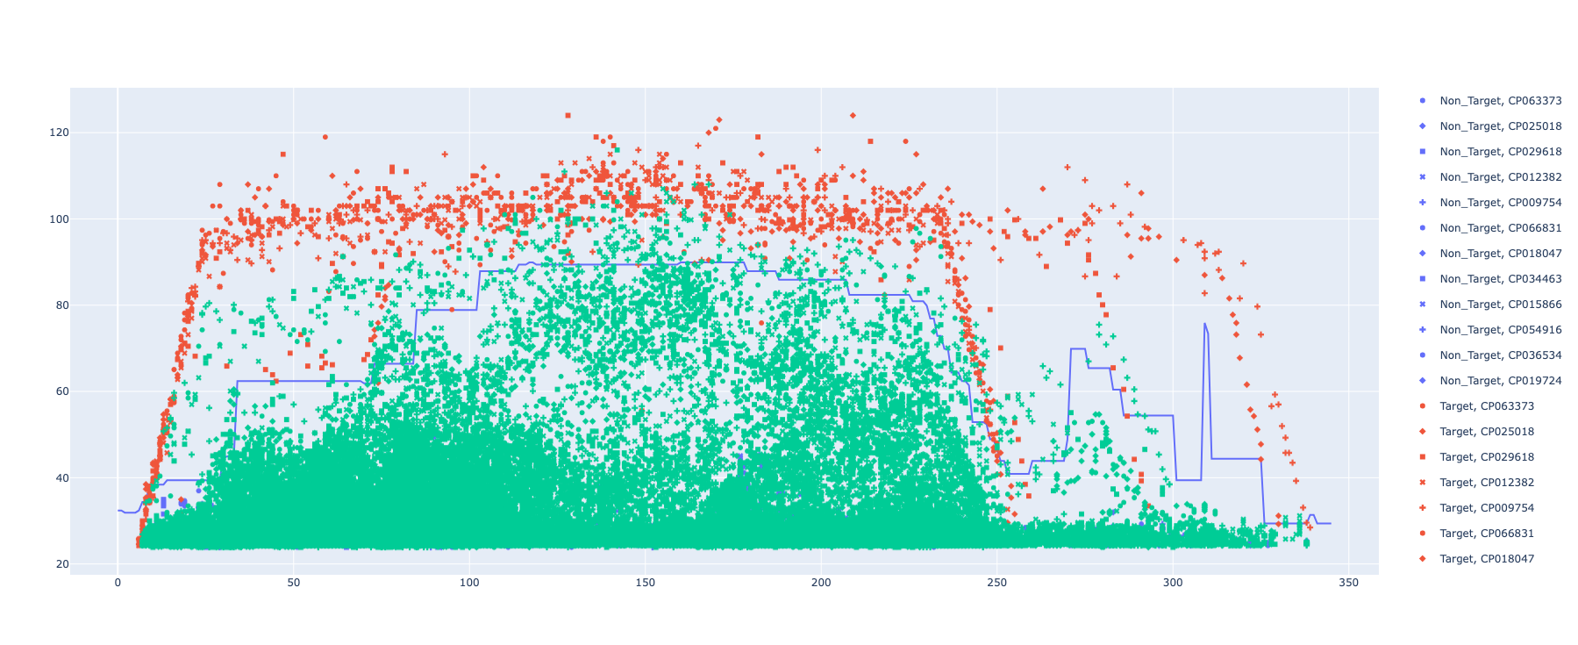
ermO ROCker model using ROCkOut – 150bp reads

Slide 11
Model 4
ermU Clade positive
All other clades negative

Slide 12
ermX+
ermO
ermD
ermD
ermB+
Model 1: ermU
Positive
Negative
No erm genes
Ribosomal RNA small subunit methyltransferase A
0.8

Slide 13
ermU ROCker model using ROCkOut – 150bp reads

Slide 14
Model 5
ermU, erm46 Clade positive
All other clades negative

Slide 15
ermX+
ermO
ermD
ermD
ermB+
Model 1: ermU, erm46
Positive
Negative
No erm genes
Ribosomal RNA small subunit methyltransferase A
0.8

Slide 16
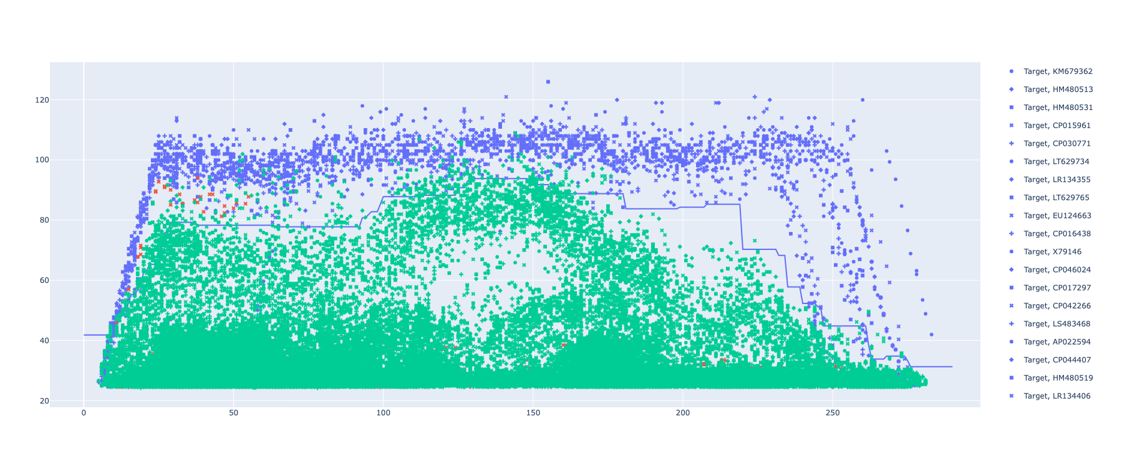
ermU, erm46 ROCker model using ROCkOut – 150bp reads

Slide 20
Model 6
erm# Clade positive
All other clades negative

Slide 21
ermX+
ermO
ermD
ermD
ermB+
Model 1: erm#
Positive
Negative
No erm genes
Ribosomal RNA small subunit methyltransferase A
0.8

Slide 22
erm# ROCker model using ROCkOut – 150bp reads

Slide 23
Model 7
Erm# Clade positive
All other clades negative

Slide 24
ermX+
ermO
ermD
ermD
ermB+
Model 1: erm#
Positive
Negative
No erm genes
Ribosomal RNA small subunit methyltransferase A
0.8

Slide 25
erm# ROCker model using ROCkOut – 150bp reads

